Slide 1
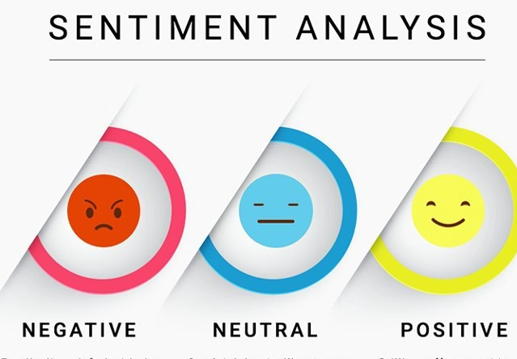
SENTIMENT ANALYSIS APPROACH FOR EVALUATION OF SOCIAL AND ENTERTAINMENT EVENTS
Abdullah Alnoamany , Bader Abanmi , Yasir Almutairi
Notes:
NOTE:
To change the image on this slide, select the picture and delete it. Then click the Pictures icon in the placeholder to insert your own image.

Slide 2
Content Layout
Introduction
Problem statement
Objectives
Data Source
EDA (Expletory data analysis)
Data cleaning
Data labeling
CrowdSourcing process
Features Engineering
Model Selection
Model Building
Model Evaluation
Best Model Performance Details
Lexicon
Required resource
Difficulties
Conclusion and future work

Slide 3
Introduction:-
The Saudi Commission for Tourism and National Heritage (SCTH), announced the an experimental launch of the “Saudi Seasons 2019”
This creates an opportunity to analyze the overall public opinion regarding this experimental launch.
We utilized the ongoing Riyadh season to collect the data needed.
Measuring the public sentiment is a task that needs time and effort due to the large size of data.

Slide 4
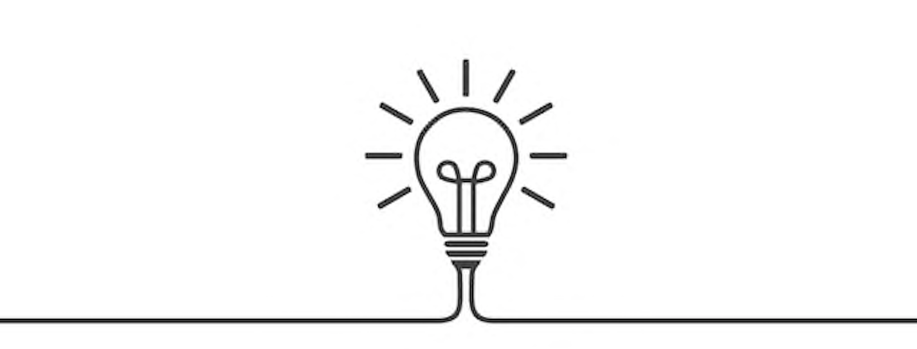
Problem statement
There are several problems we are trying to find a solution.
Specific domain Arabic sentiment analysis will be applied in this project to understand the public opinion regarding a verity of events.
The language used is Arabic (Saudi Dialect) which might be challenging due to the fact that there are few research papers in this domain specific field.
There are no pre-defined Saudi Dialect dictionary’s related to the entertainment domain and limited pre-defined stop words.

Slide 5

Objectives
Analyzing the overall sentiment of what the public found entertaining and what failed to entertain.
Create a lexicon that will contribute to the Arabic academic research society related to the entertainment domain.
By using this lexicon model, researchers can use it to classify a sentiment
Make our cleaning pipeline an open source

Slide 6

Data Source
There are many sources of data that represent opinion. Therefore when trying to analyze large potions of public opinion we are limited to social media.
We considered twitter as the main data source since it’s the largest text based social media platform in Saudi Arabia.
We collected from twitter using the official API to request the most trended hashtags during Riyadh season.
Up until this stage we collected the official hashtags of four of the top trending events at that time.

Slide 7

The events
SAHM
#Tweets (31,548)
#Positive (1,358)
#Negative (122)
#Nuatral (22)
Winter Wonder Land
#Tweets (3,876)
#Positive (703)
#Negative (490)
Riyadh Boulevard Carnival
#Tweets (15,288)
#Positive (1,240)
Colors Marathon
#Tweets (15,452)
#Positive (1,146)
#Nuatral (285)
#Negative (544)
#Nuatral (33)
#Nuatral (54)
#Negative (90)

Slide 8
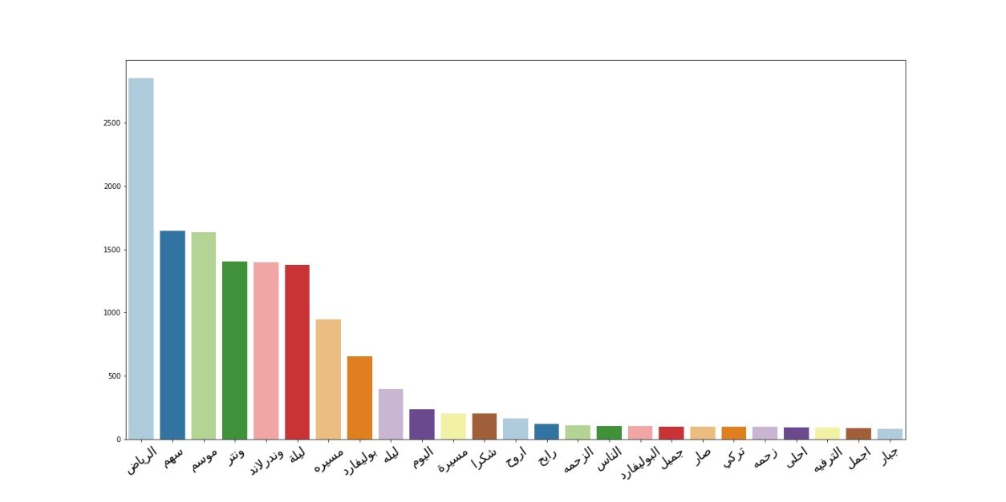
EDA (Expletory data analysis)
Term frequency of all events

Slide 9

EDA (Expletory data analysis)

Slide 10
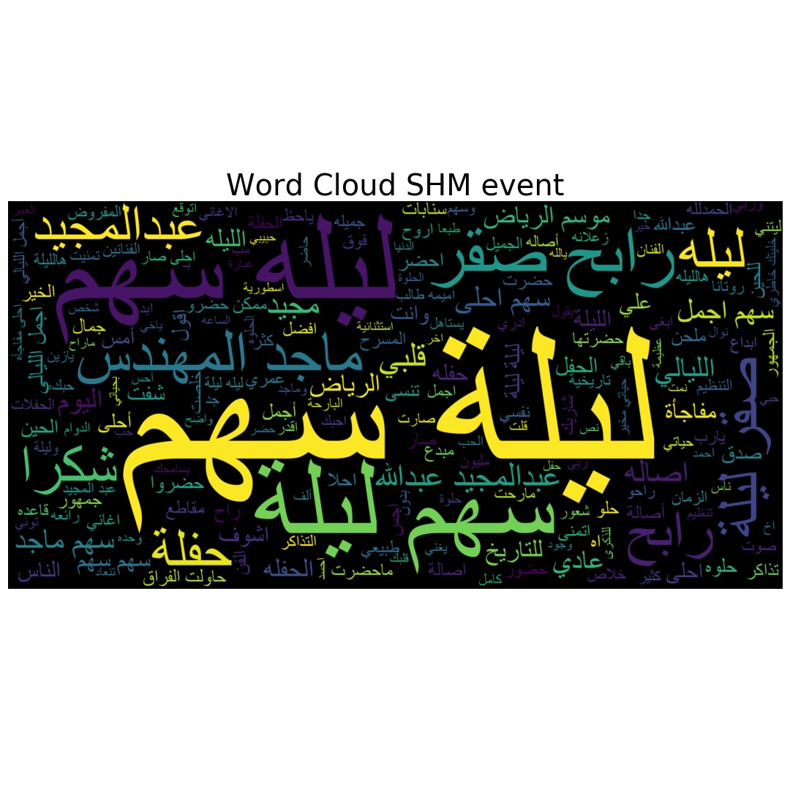
EDA (Expletory data analysis)

Slide 11

EDA (Expletory data analysis)

Slide 12
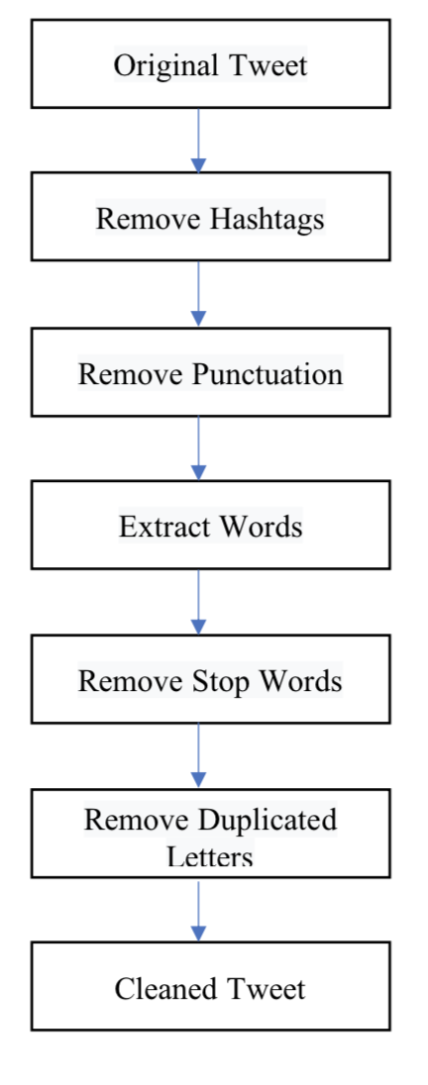
Data cleaning
Data cleaning is the process of identifying and removing the errors in the dataset. It's an important step that will affect the final score of our model if we didn’t have high quality data

Slide 13
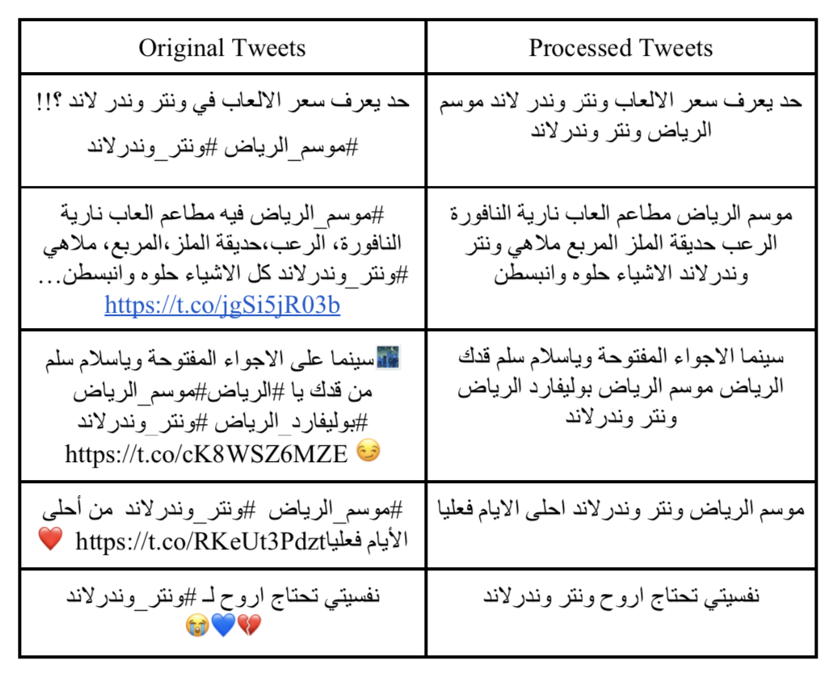
Data cleaning

Slide 14
Data labeling
The approach we took is labeling tweets manually for each events and passing the labels to each other for rechecking and second opinion.
We classify the tweets into three way classification which is ( positive , negative , neutral )
Text | Classification | Label
بوليفارد الرياض صار عباره عن ****غريبه ماتحطون قوانين وغرامات *****الي ترميي وتوصخ والله شي يقهرر - | Negative | 0
من راح لموسم الرياض شغل جبار بس التنظيم سيئ والنافورة كاتبين ١٠ ونص ومابدت الا ١٢ واشتغلت دقيقتين | Neutral | 2
ابي اروح ليله سهم 😞 ❤️ | Positive | 1

Slide 15
CrowdSourcing process
Data
The data given was for SHM event with 30,000 tweets
Each student was given 500 tweets
Chick the accuracy
each student was evaluated his task by measuring his accuracy to be above 80%
Labeled Data
Set the golden indexes
By using data we have labeled it before
shared the data files with cloud

Slide 16
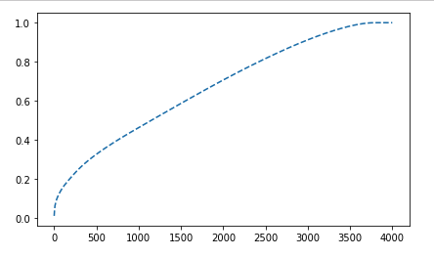
Features Engineering
Total amount of features that we have is 32,000
Using PCA which is an unsupervised, non-parametric statistical technique primarily used for dimensionality reduction in machine learning

Slide 17
Model Selection
Ridge Classifier
Logistic Regression
KNeighbors Classifier
SGD Classifier
AdaBoost Classifier
SVC
Bagging Classifier
Random Forest Classifier

Slide 18
Model Building
Model
Modeling without Stemming.
Modeling with Stemming.
With Tf-Idf
With CountVect
With Tf-Idf
With CountVect

Slide 19
Model Building
Model
Modeling without Stemming.
Modeling with Stemming.
With Tf-Idf
With CountVect
With Tf-Idf
With CountVect
The stemming process has done by using the Tashaphyne library,
which is an Arabic light stemmer and segment. It mainly supports light stemming (removing prefixes and suffixes) and gives all possible segmentations.

Slide 20
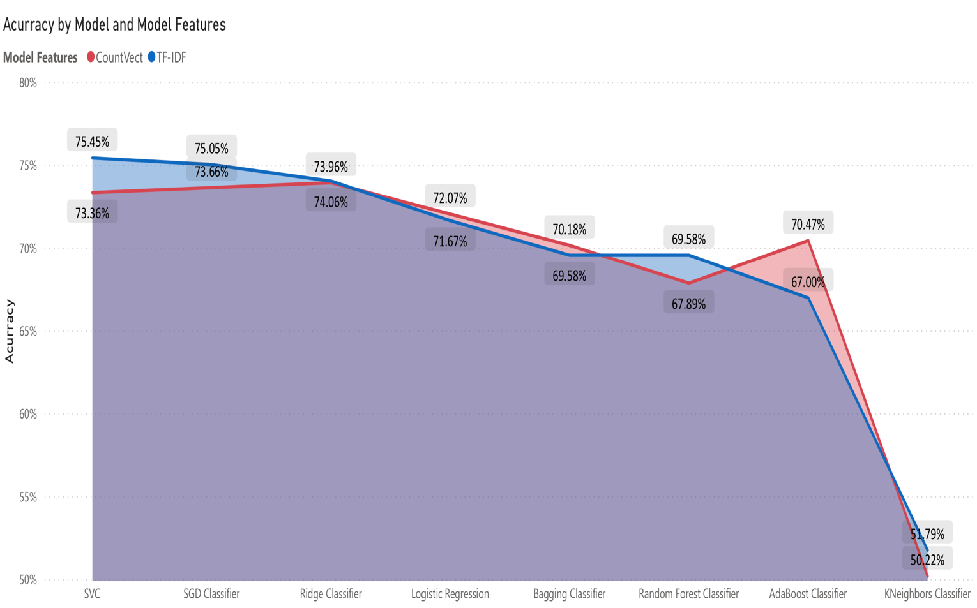
Model Evaluation
With Steaming

Slide 21
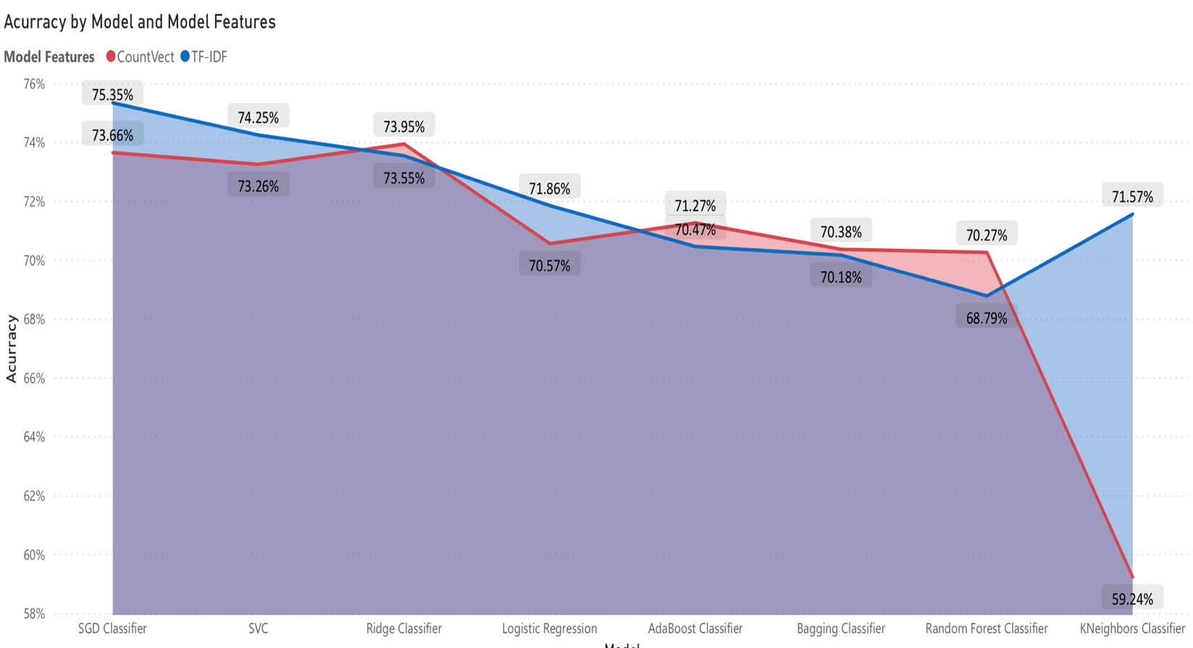
Model Evaluation
Without Steaming

Slide 22
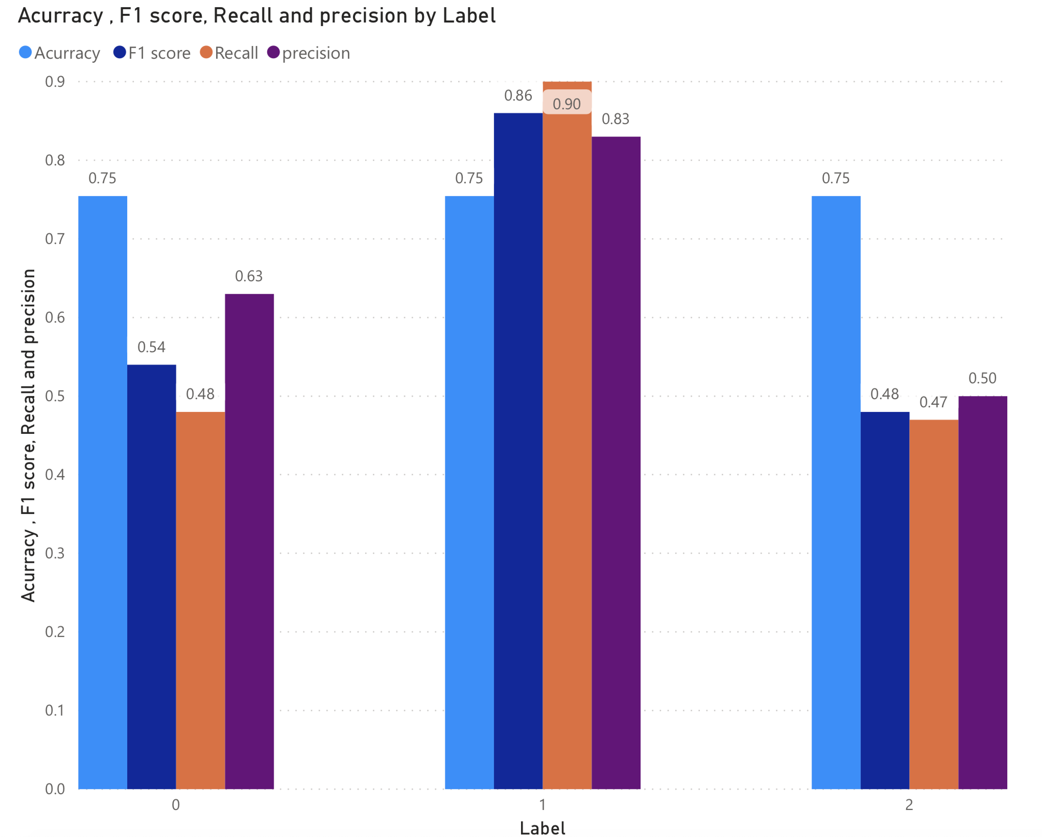
Best Model Performance Details
Precicsion: measure of accuracy
Recall : Postive Rate
F1 Score : avg of precision and Recall

Slide 23
Lexicon
Positive | Negative
العملل جبار | الخدمة سيئة
واسطوري ونتر | يصير يفشل
افضل موسم | واشغلونا يشغلهم
جابو لندن | وزحمه بالحيل
اتحمست اروح | الزحمة مخربه
جميل ماتوقعتها | تنظيم بريال

Slide 24
Required resource
Since the modeling process requires a high computing power we have used the google cloud Colab with 32 Giga ram

Slide 25
Difficulties
Coding errors
Ensure that the labeling process is correct
Limitation of twitter API for collecting data
Advertisements between tweets
Different ways of expressing an opinion in the local dialect
Classifying neutral tweets

Slide 26
Conclusion
In this project, we proposed a Sentiment Analysis Approach for the Entertainment Events domain which contains 62,000 tweets. Our data was labeled manually into 3 categories. We have applied many experiments with different models and combinations of features trying to get the most accurate model, most of the dataset was a positive tweets more than the other categories.
The best two models were :
SVC classifier with steaming and tf-idf with 75.45% of accuracy.
SGD classifier with tf-idf and without steaming with the accuracy 75.35%.

Slide 27
Future work
enhance our results and improve our sentiment lexicon content
expand the experiments and try to implement the different features
publish the lexicon and our project to the public to support the Arabic analysis community Due to the limited number of published works in the field of entertainment and events in particular

Slide 28


